Slide 1



Title: Web Scraping and Exploratory Data Analysis of Flipkart Product Sales Data

Slide 2
About us:
Grandhi Deekshita
B.Tech ECE Graduate | Data Analytics & Visualization Skilled in Python, SQL, Web Scraping & EDA
LinkedIn: https://www.linkedin.com/in/grandhi-deekshita-7a0940251/ GitHub: https://github.com/GrandhiDeekshita
Ravipati Harika Priya
B.Tech ECE Graduate | Data Analytics Enthusiast Interested in data cleaning & exploratory insights.
LinkedIn: https://www.linkedin.com/in/ravipatiharikapriya/ GitHub: https://github.com/ravipatiharikapriya.com
Javisetty Vijaya Rani
B.Tech ECE Graduate | Data Analytics Learner Focused on visualization & trend analysis.
LinkedIn: https://linkedin.com/in/vijaya-rani-javisetty-7a0a532b0 GitHub: https://github.com/javisettyvijayarani

Slide 3

Flipkart Web Scraping & EDA Project
This project focuses on extracting data of smartphones, laptops, and tablets from Flipkart. It utilizes Python libraries such as Requests and BeautifulSoup for web scraping, followed by data cleaning to organize unstructured information into a structured format. Subsequent exploratory data analysis (EDA) aids in uncovering insights.
JD
Notes:
The Flipkart Web Scraping and EDA project involves three main phases. The first phase is web scraping, where data for smartphones, laptops, and tablets is extracted using Python libraries like Requests and BeautifulSoup. Second comes data cleaning, which organizes this unstructured data into a structured format. Lastly, we apply exploratory data analysis to derive meaningful insights from the cleaned data.

Slide 4
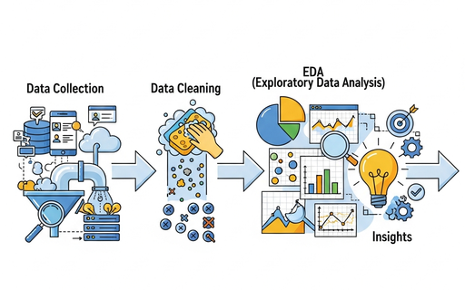
Our Objectives
The goal is to systematically gather product details, clean the data, and employ exploratory data analysis (EDA) to uncover valuable insights.
Notes:
To overcome the existing challenges, our objectives focus on the systematic collection of product details and the subsequent cleaning of this data. We aim to employ exploratory data analysis to reveal essential insights that can drive decision-making and strategy.

Slide 5
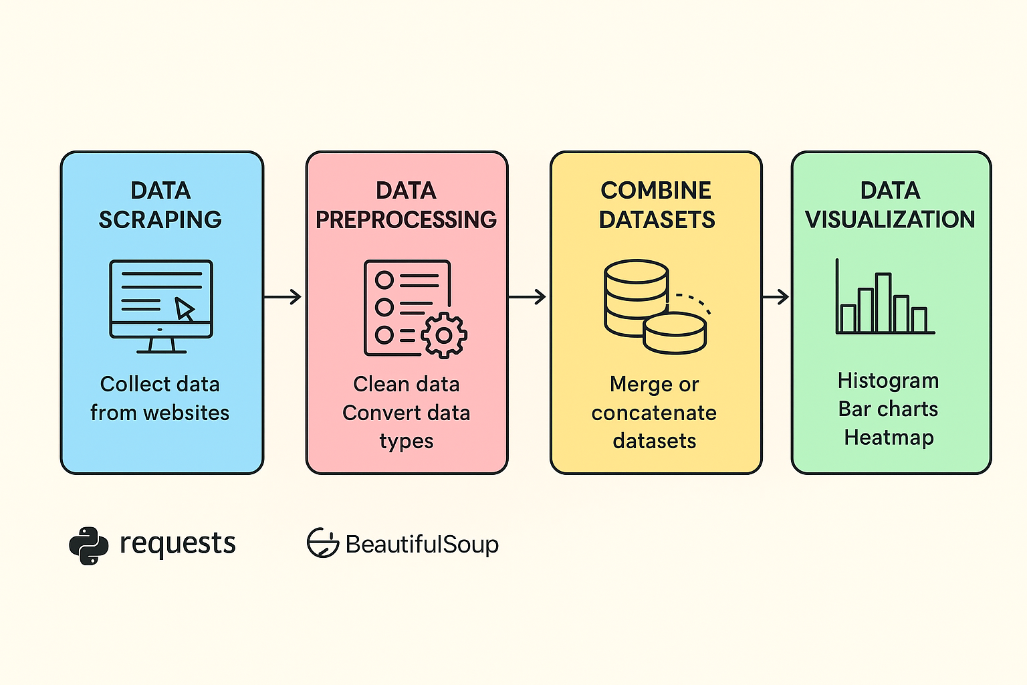
Project Objectives
Key objectives include extracting data from Flipkart, data cleaning for analysis, merging datasets of smartphones, laptops, and tablets, and visualizing pricing, brands, and RAM trends.
Notes:
The project focuses on several objectives crucial for effective analysis. Firstly, we will extract relevant product information from Flipkart. Next, we will clean and standardize this data to prepare it for analysis. After that, the datasets comprising smartphones, laptops, and tablets will be merged for comprehensive insights. Finally, we will visualize trends relating to pricing, brands, and RAM to uncover valuable patterns.

Slide 6
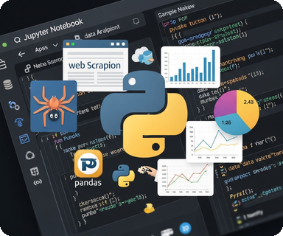
Tools Utilized for Data Analysis
Programming Language: Python
Data Manipulation & Visualization
Pandas, NumPy, Matplotlib, Seaborn
Web Scraping Libraries
Requests & BeautifulSoup
Notes:
Key tools used in data analysis include Python as the primary programming language, complemented by important libraries for web scraping like Requests and BeautifulSoup. For data manipulation, Pandas and NumPy are essential, while visualization is efficiently conducted with Matplotlib and Seaborn. Jupyter Notebook serves as the platform for executing these analyses.

Slide 7
Problem Statement
Flipkart hosts thousands of products with varying prices, brands, and specifications, making it difficult to understand market trends and customer preferences.
There is no direct way to analyze how factors like RAM, storage, brand, and ratings influence product pricing.
This project aims to collect, clean, and analyze Flipkart product data to uncover valuable insights about pricing patterns, brand performance, and customer satisfaction.
Flipkart product details are not directly available in CSV format; the information exists in unstructured HTML, which requires careful web scraping and parsing.
Different sellers list specifications in different formats (e.g., “8 GB RAM” vs “8GB”), making it difficult to standardize the data for meaningful comparison.

Slide 8
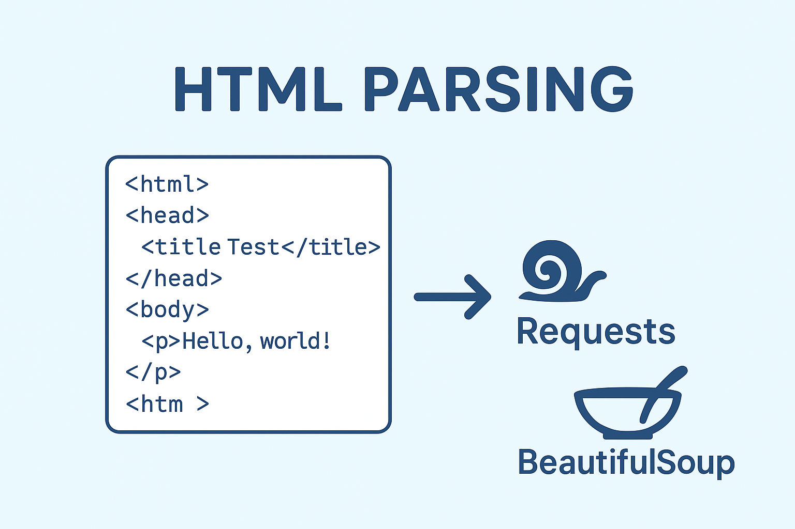
Web Scraping Workflow
The process consists of making requests to fetch HTML, parsing with BeautifulSoup, and extracting key details like prices, brands, and specs. It also requires looping through multiple pages for thorough data acquisition.
Notes:
The web scraping workflow is vital for gathering information online. First, requests are made to retrieve HTML pages. Following that, BeautifulSoup allows for parsing the HTML to find and extract important data such as prices and specifications. Lastly, pagination is an important aspect for continuity in data collection, allowing for a detailed overview across multiple pages.

Slide 9
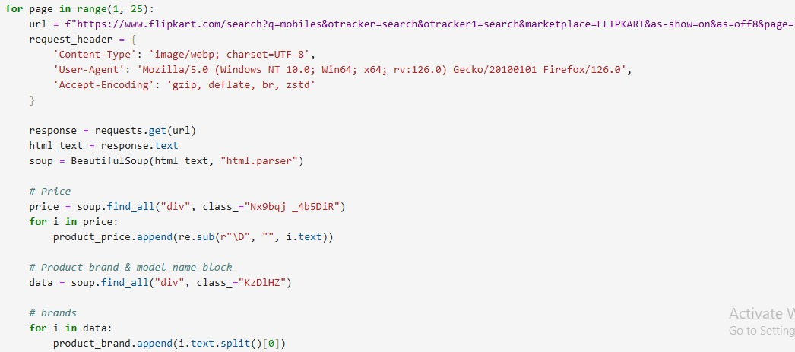
Web Scraping
Flipkart’s official website was selected as the main data source for collecting product information such as name, price, brand, RAM/ROM, and ratings across categories like mobiles, laptops, and tablet.
The scraped data was then cleaned and stored in a structured format for further analysis and visualization.
Used Inspect Element to find data and collected product details from multiple pages automatically.
Used BeautifulSoup and Requests libraries in Python to extract structured data from the web pages

Slide 10
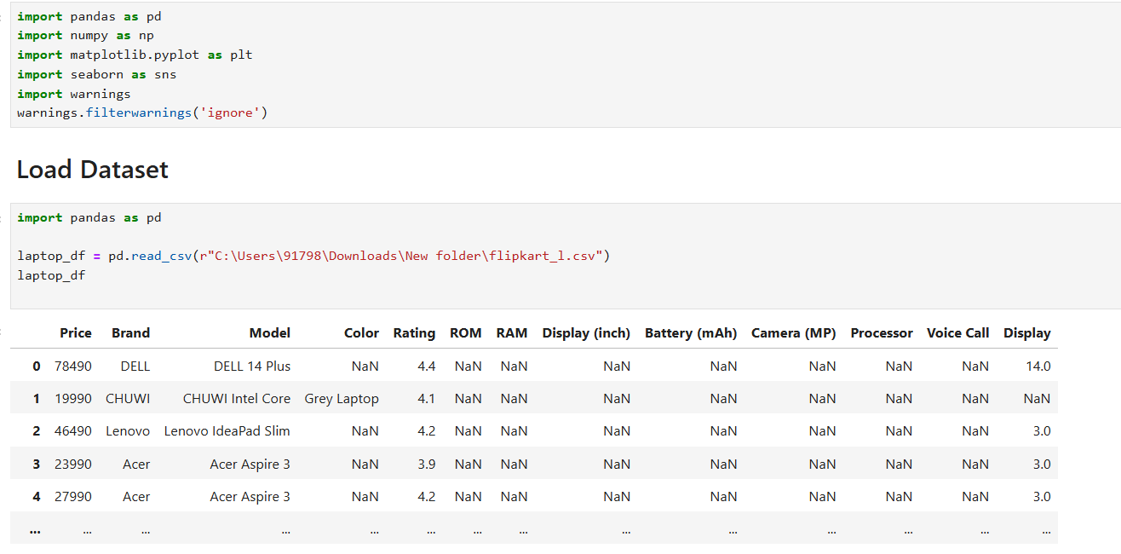
Data Cleaning Steps
Removed unwanted characters and symbols such as ₹, commas, and extra spaces from product prices and ratings.
Standardized and reformatted brand and model names for consistent entries across the dataset.
Converted price and rating columns from string/object to numeric type for proper analysis.
Handled missing or incomplete values in columns like RAM, ROM, and Display by filling with defaults or removing null entries.
Merged data from multiple categories (Mobiles, Laptops, Tablets) into one unified dataset for analysis.

Slide 11
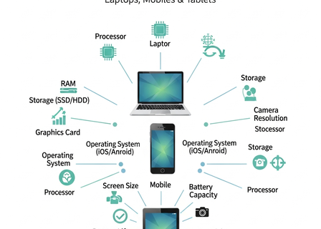
Dataset Overview
The dataset provides insights into various product specifications and characteristics, useful for comparisons and analysis.
Key Attributes
The dataset includes essential product details such as price, brand, model, and color to aid user choice and comparisons.
Technical Specifications
Information on RAM, ROM, battery, display size, processor, and camera enhances understanding of product capabilities.
Product Categories
Categorization into Laptops, Mobiles, and Tablets for tailored user experiences and insights.
Notes:
The dataset overview highlights the various attributes that are integrated for a comprehensive analysis of products like laptops, mobiles, and tablets. This includes key aspects such as product price, brand, model, and color. Additionally, it covers technical specifications like RAM, ROM, battery capacity, display size, processor details, and camera capabilities. Lastly, products are categorized into laptops, mobiles, and tablets to facilitate targeted insights and comparisons.

Slide 12
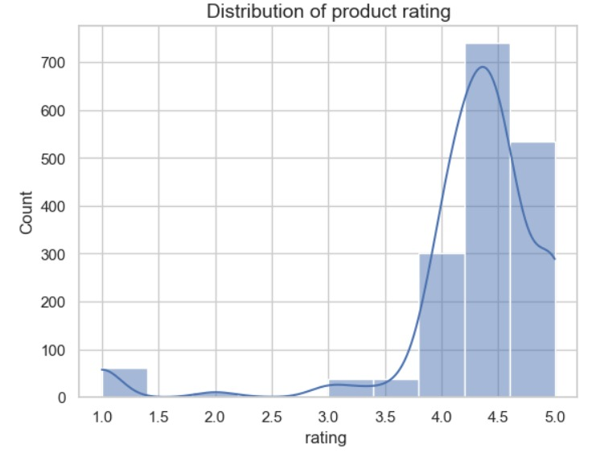
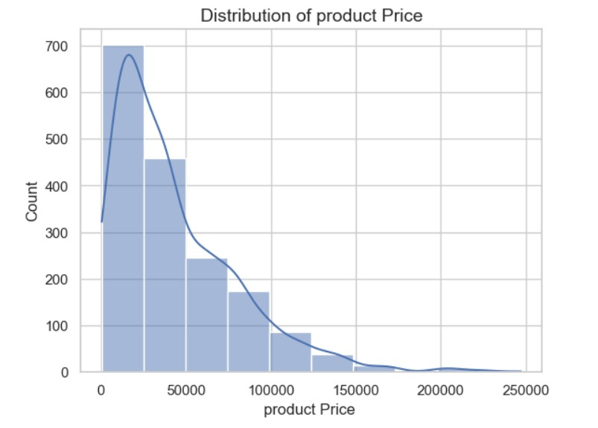
Data Visualization
Distribution of Product Price Most products are priced below ₹50,000.Price distribution is right-skewed — few high-priced products.
Indicates majority of products are affordable, with only a few premium ones.
Distribution of Product Rating Most ratings fall between 4.0 and 4.8.Rating distribution is left-skewed — majority are highly rated.
Suggests good product quality and high customer satisfaction.

Slide 13
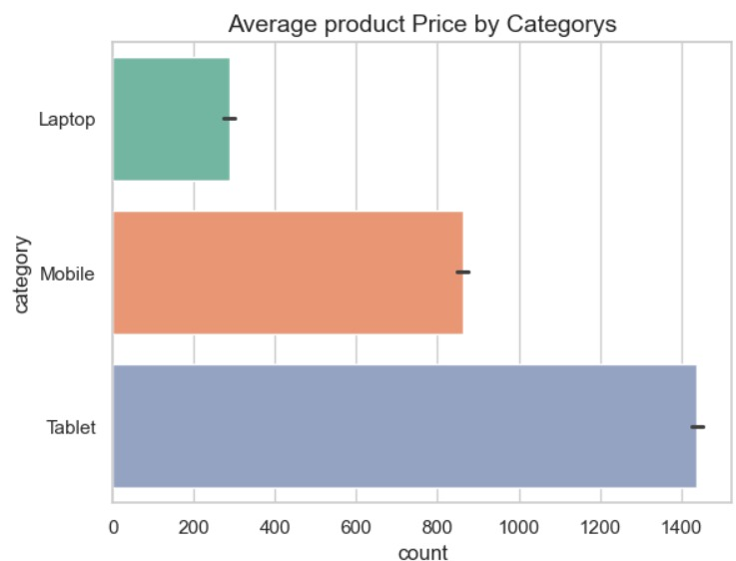
Data Visualization
Average Rating by Category This bar chart shows the average customer rating for each product category — Laptop, Mobile, and Tablet.
All categories have high ratings (around 4 to 4.5), indicating overall customer satisfaction.
Tablets have the highest average rating, followed by Mobiles and then Laptops.

Slide 14
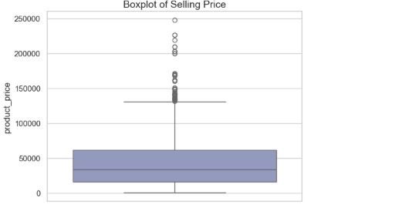
Data Visualization
This boxplot shows the distribution of product prices on Flipkart.
The median price lies around ₹40,000–₹50,000, meaning most products are in the mid-price range.
The box area represents the interquartile range (middle 50% of prices).
Overall, most Flipkart products are affordable to mid-range, with a few expensive models increasing the price spread.

Slide 15
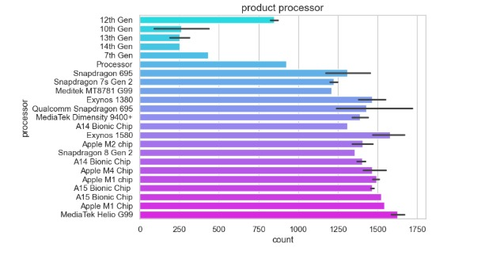
Data Visualization
Product Processor Distribution This bar chart shows the count of products by processor type.
MediaTek Helio G99 and Apple M1 Chip are the most common processors, with the highest product counts.
A15 Bionic and Snapdragon series also have significant representation.

Slide 16
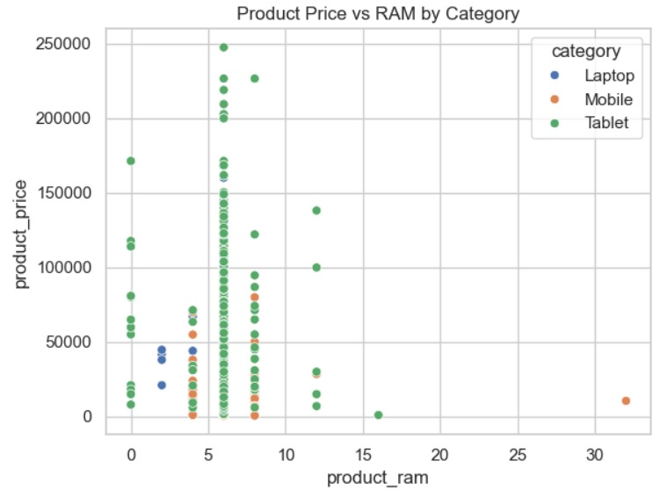
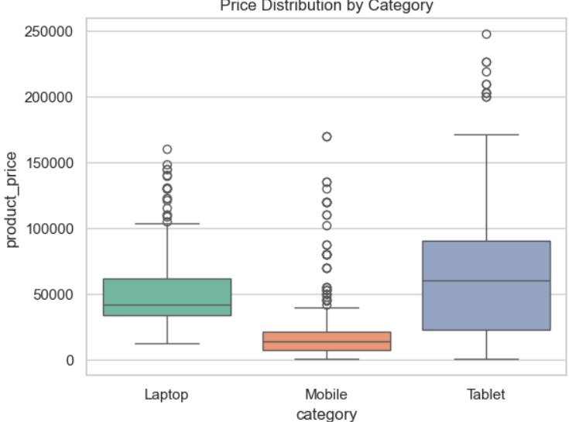
Data Visualization
1. Product Price vs RAM by Category (Scatter Plot)
This scatter plot shows the relationship between RAM size and product price for different categories (Laptop, Mobile, Tablet).
RAM capacity usually indicates a higher product price across all categories.
2. Price Distribution by Category (Box Plot)
This box plot compares price variation across three product categories — Laptop, Mobile, and Tablet.
Flipkart listings show that Laptops and Tablets dominate the premium range, while Mobiles cover the budget segment.

Slide 17
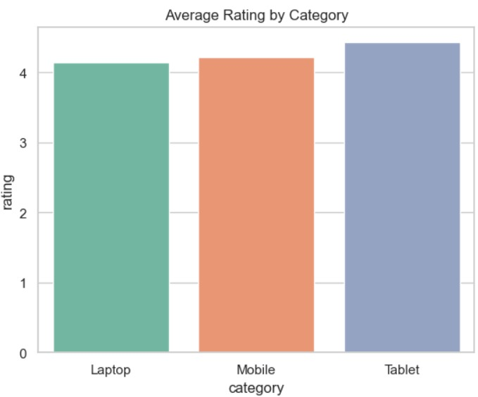
Average Rating by Category (Bivariate Analysis)
Compares Category and Average Rating.
All categories rated between 4.0–4.5.
Tablets have the highest ratings.
Shows overall high customer satisfaction.

Slide 18
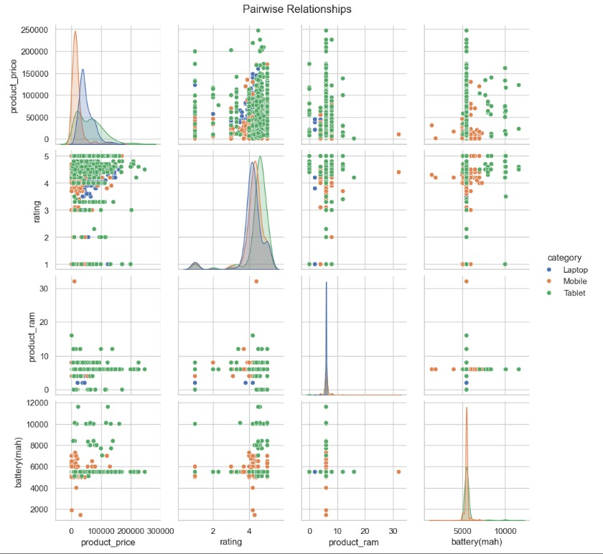
Pairwise Relationships (Multivariate Analysis)
Shows relation among Price, Rating, RAM, Battery by category.
Higher RAM → Higher Price trend visible.
Ratings stay high across all devices.
Useful to study multiple variables together.

Slide 19
Key Business Questions
Which brands have the highest number of products listed on Flipkart?
What is the price range where most products are sold?
How does RAM or storage capacity affect the product price?
Which category (Mobile, Laptop, Tablet) receives the highest average rating?
Is there a relationship between price and customer rating?

Slide 20

Conclusion
The Flipkart Web Scraping & EDA project showcases efficient strategies for extracting and cleaning web data, utilizing analytical techniques for enhanced market insights.
Most products are in the mid-range price segment (₹10,000–₹50,000), showing high demand for affordable options.
Brands like HP, Dell, Samsung, and Redmi dominate in their respective categories.
Tablets have the highest average ratings, followed by Mobiles and Laptops.
The analysis highlights how Python tools can turn raw web data into useful business insights about pricing, performance, and customer preferences.
Notes:
This conclusion highlights the key takeaways from the Flipkart Web Scraping and EDA project. It emphasizes the effective strategies employed for web data extraction and cleaning, which are critical for any data-driven analysis. Additionally, it points out the insightful applications of analytical techniques that help in understanding market trends and consumer behavior. Finally, it underlines how this project equips aspiring Data Analysts with practical data science skills, enhancing their readiness for real-world challenges.

Slide 21
THANK YOU

